Slide 2
MINISTRY OF HEALTH
Panamá con salud y bienestar
General Health Direction
Department of Clinical Laboratory Regulation August 2024
Mgter David Cortés

Slide 3
HIV RAPID TEST CERTIFICATION PROGRAM IN IN PANAMA
PROCER

Slide 5
What is the HIV RT Certification Program?
This program stipulates the minimum requirements that must be met by services that perform HIV rapid tests. It also provides tools for this facilities staff to fill the gaps that are detected in the evaluations. In addition, it details the aspects to be considered to opt for the renewal of the certification of the services

Slide 6
Main Goal and Scope
Establish quality assurance standards to be met by all facilities that perform rapid HIV diagnostic tests, as well as mechanisms for eligibility for certification in the performance of these tests.
It applies to any institution that performs HIV test.

Slide 7
Specific objectives
Be a guide for laboratories and staff certification
Define the standards related to biosafety, infrastructure, collection, handling and storage of samples, internal quality controls, external quality assessment, documentation and records
Identify the topics to be included in the training for mentors/certifiers, as well as testers
Define the period of validity of the certification and define the process for the re-certification.

Slide 8
Regional Laboratories
Train the staff of the laboratories under its jurisdiction. Systematically monitoring (e.g., bi-annually)of local facilities and ensure compliance with the standards set forth in certification program.
Assess local facilities using tools established by NRL
To analyze information obtained and send informs to central level

Slide 9
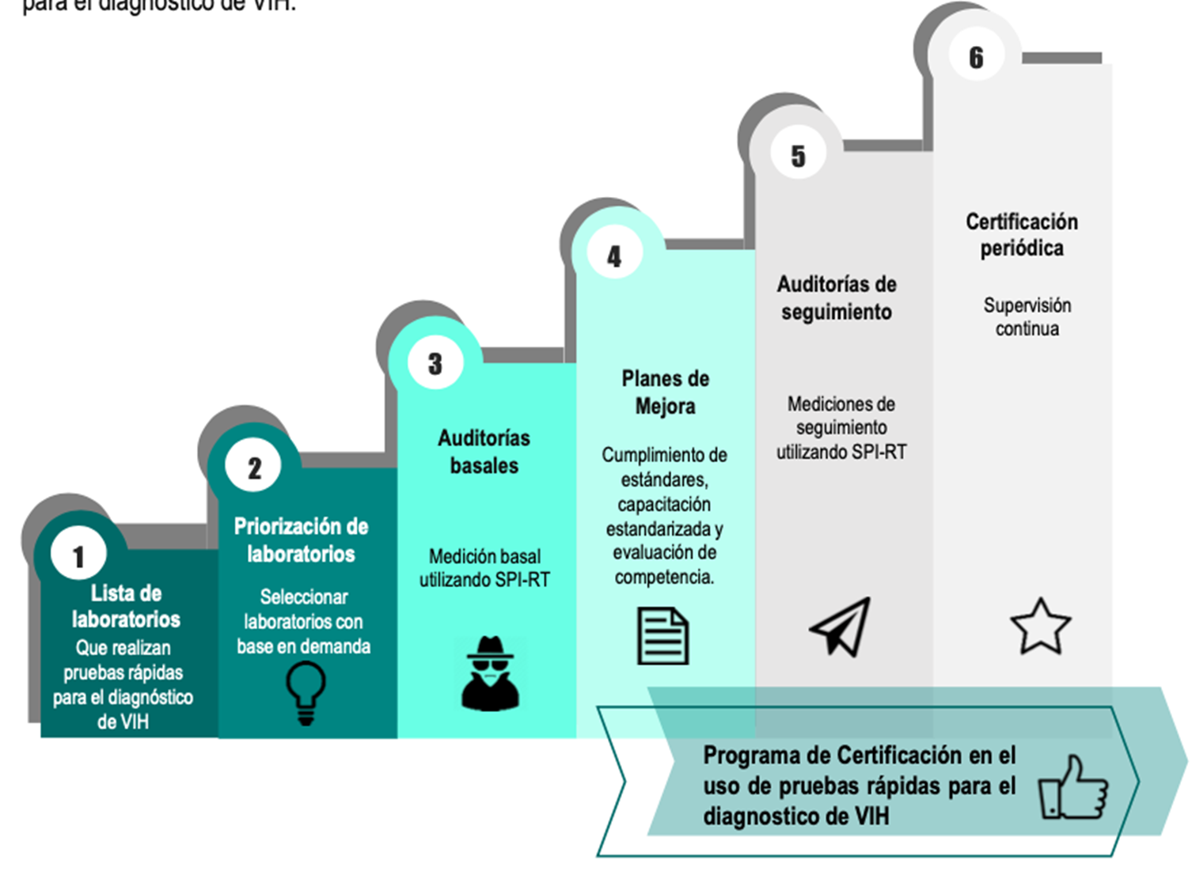
Implementación del Programa de Certificación

Slide 10
Tools used for certification program
RTCQII currucula
SPI-RT (Excel based form).
Excel spreadsheet with sites.

Slide 11
Lessons learned
Follow-up annual meetings to establish critical nodes and new goals. More robust information systems with interoperability are required.

Slide 12
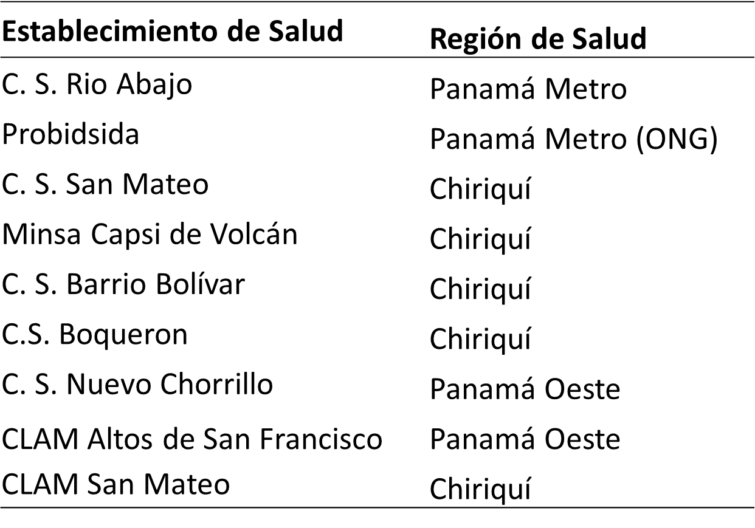
Facilities certified in 2018

Slide 13
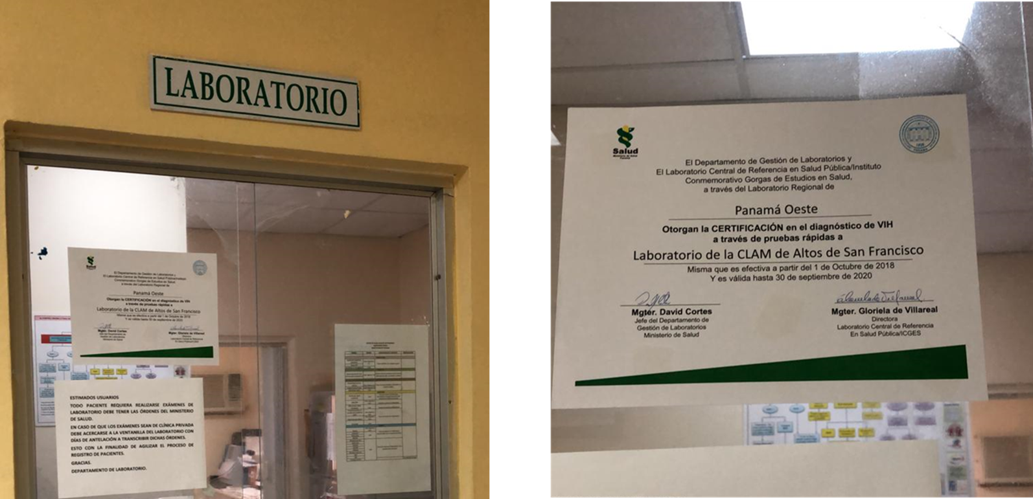
Facilities certified in 2018

